Slide 1



WR140
Finding better orbital kinematics for WR140 using eShel spectra.
By: Adler Williams and Noel Richardson

Slide 2
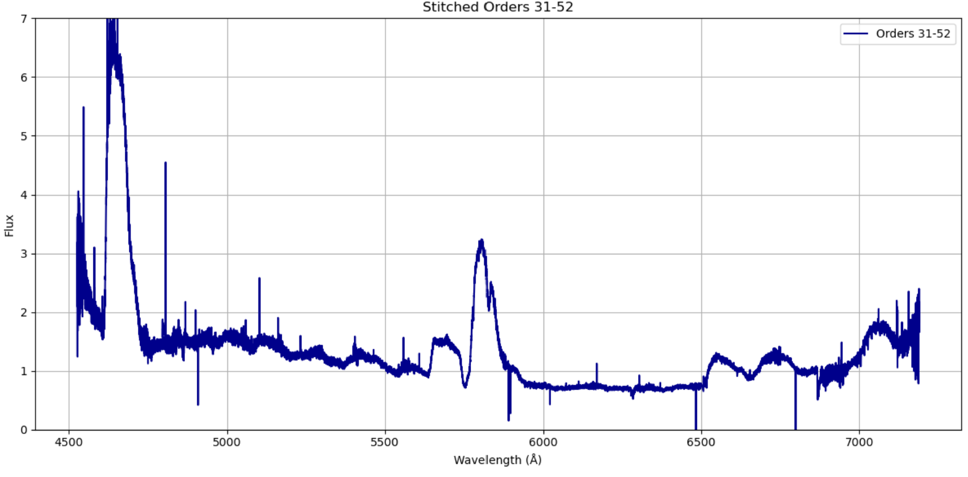
What is a Spectrum?
• Emission Lines
• Absorption lines
• Red or Blue Shift

Slide 3
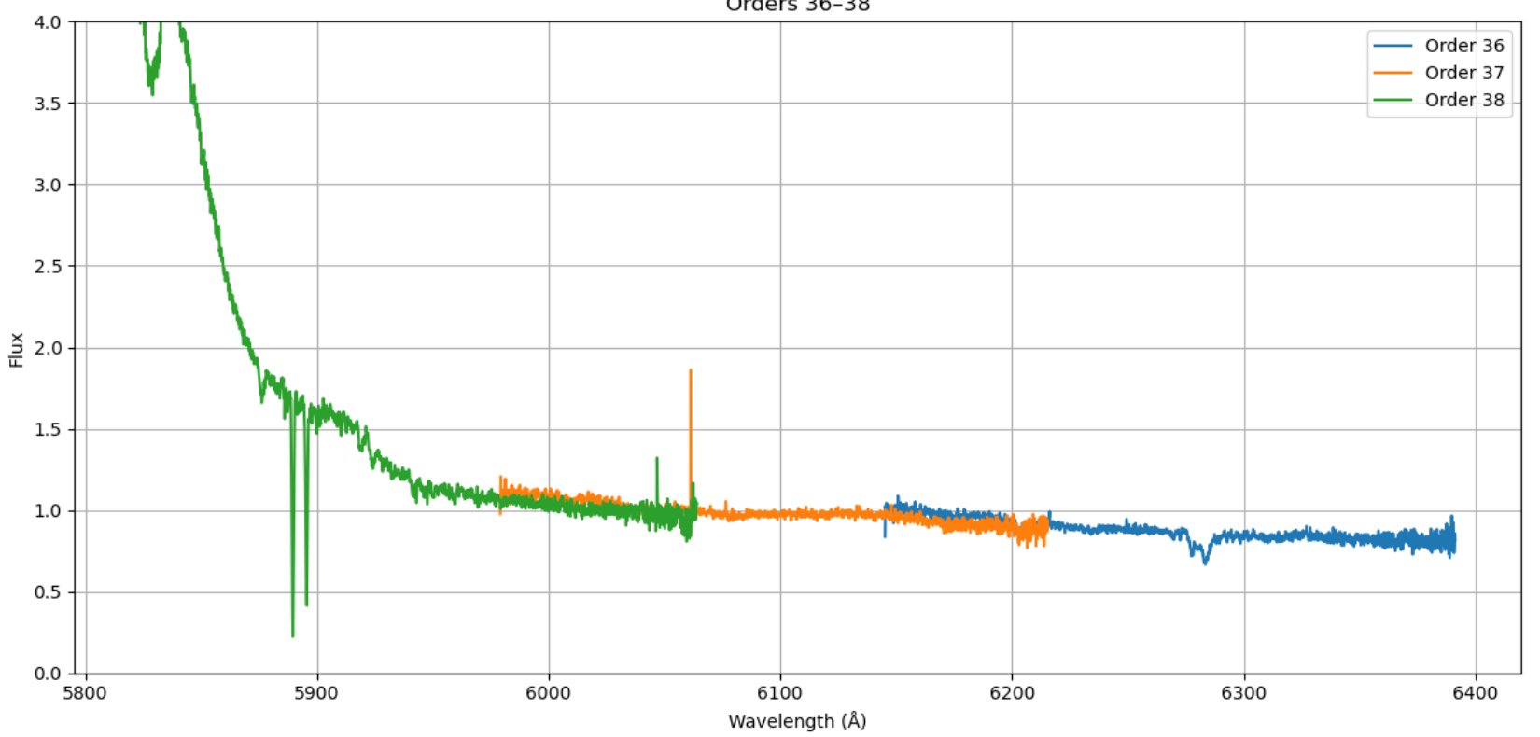
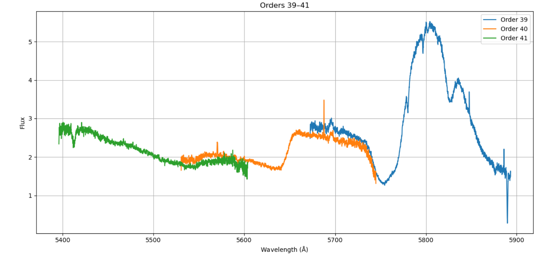
What is a Spectrum?
Absorption lines
So
Emission Lines

Slide 4
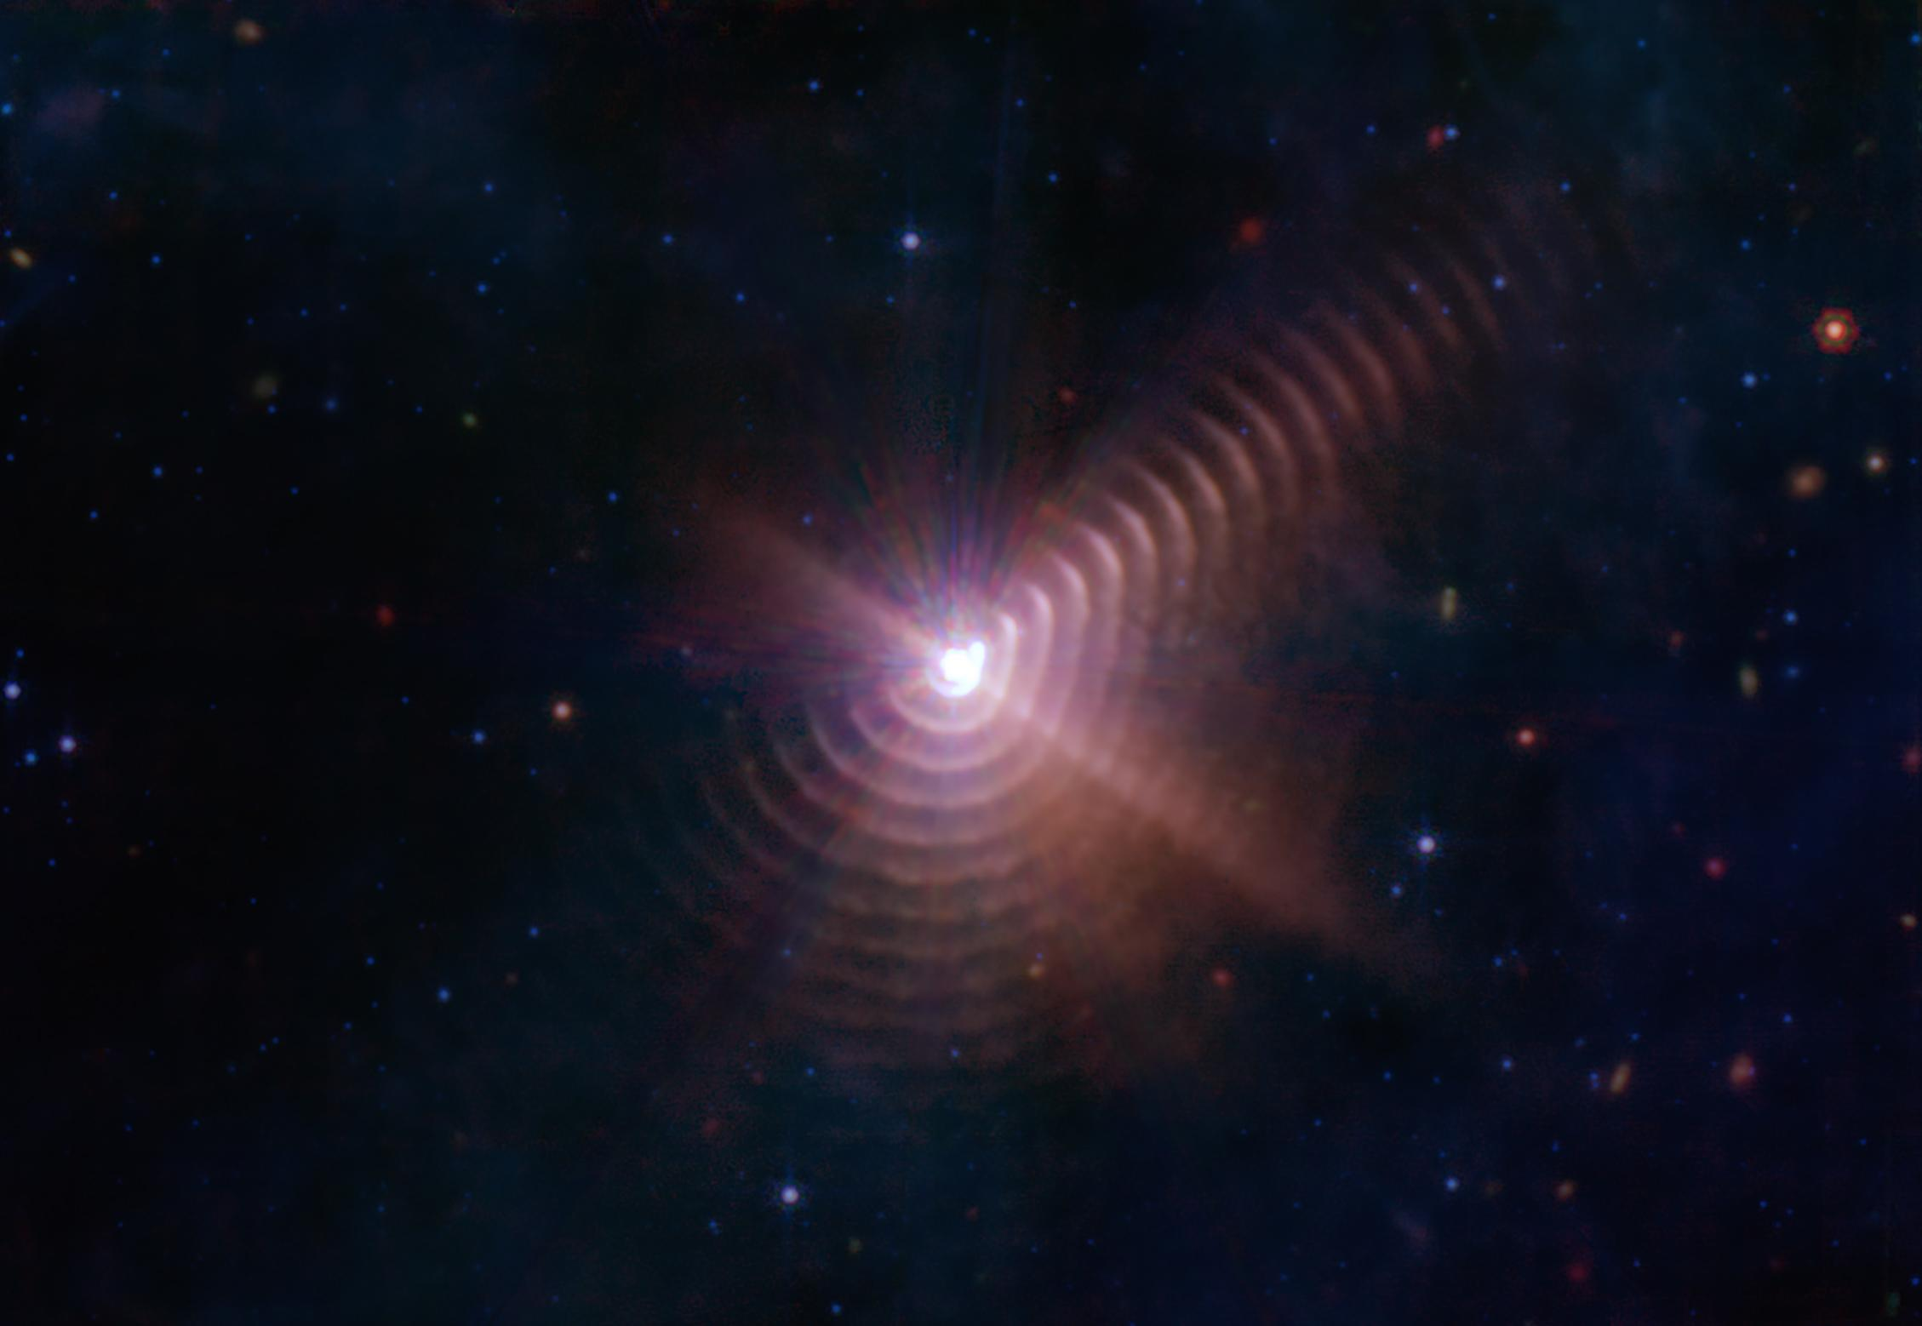
What is a WR Star?
WR or Wolf–Rayet stars are:
Massive
Hot
Luminous
In the later parts of stellar evolution
They are characterized by the lack of hydrogen in their spectra and an abundance of other elements like carbon or nitrogen.
Image by the James Webb Space Telescope

Slide 5
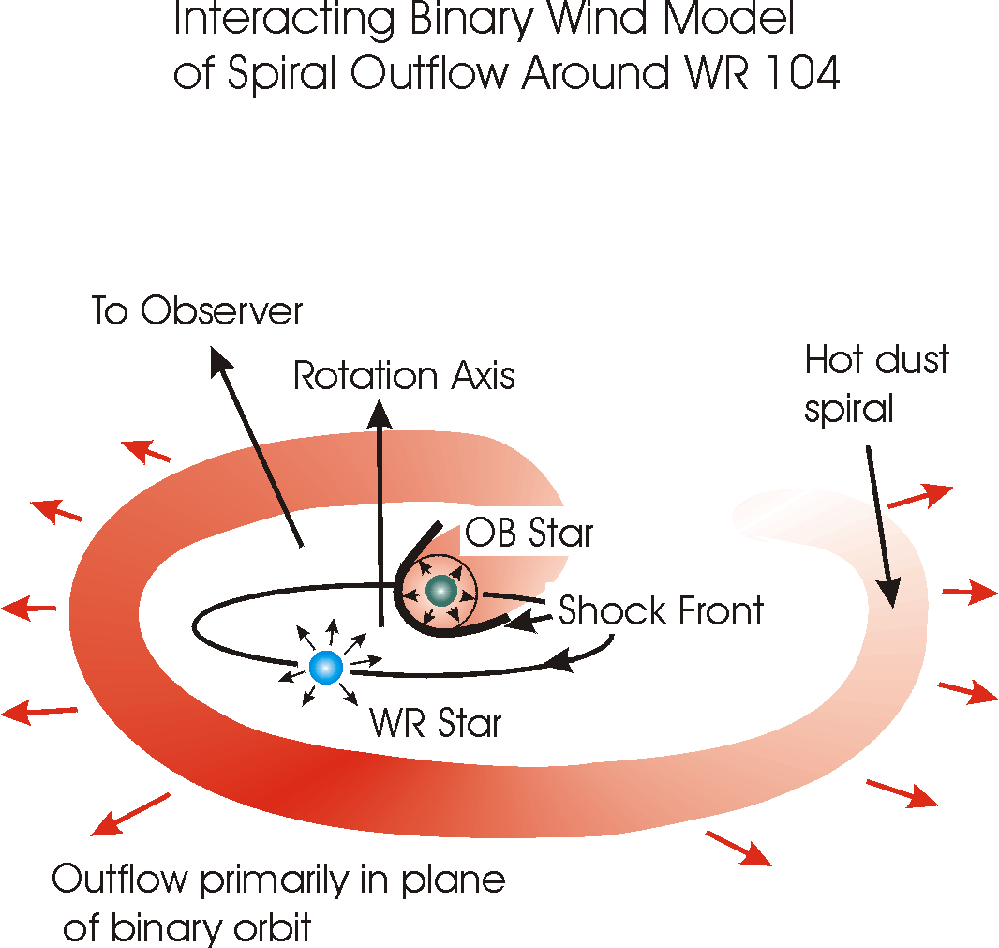
WR140
Long-period (7.94 yr), high eccentricity (e=0.8994)
  (Thomas et al. 2021)
Wolf-Rayet star orbited by a hot O star
Collision of powerful stellar winds from both stars.
Compressed Plasma makes a dust factory and leads to a broken spiral
  See picture from JWST
Diagram by W. C. Danchi

Slide 6
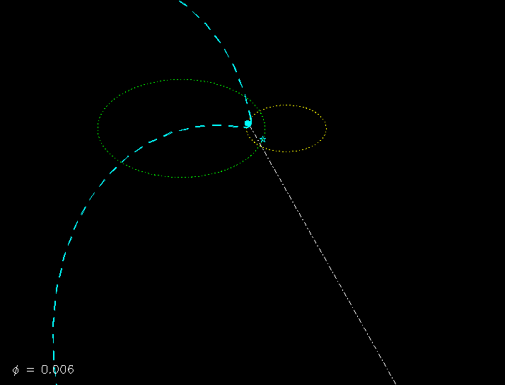
WR140 orbit
Animation by Peredur Williams

Slide 7
Preliminary results
Helium II 4685 Å
Carbon III and IV
5696 Å 5802 Å
Spectrum taken at the ERAU's
on-campus observatory. ​

Slide 8
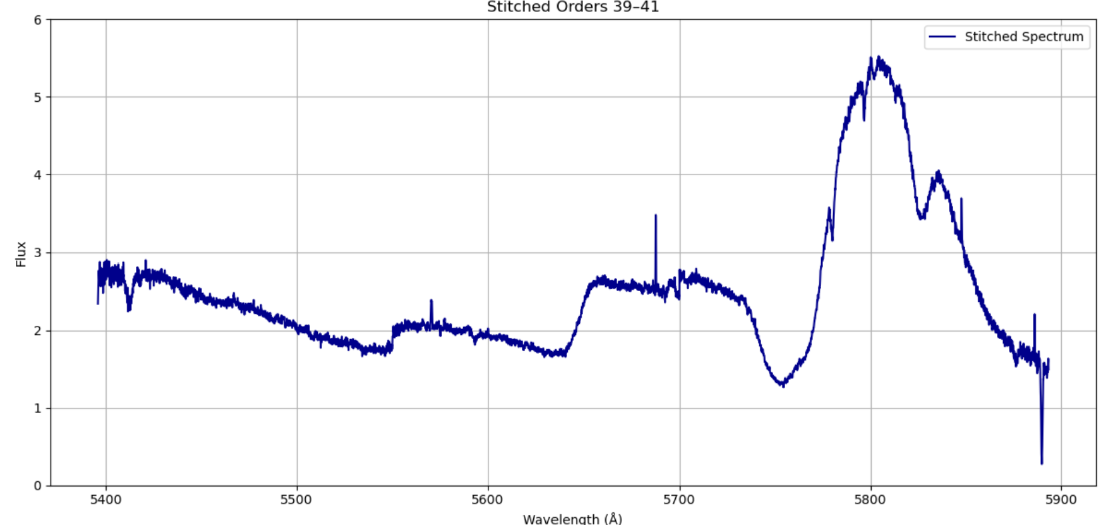
Preliminary results
Spectrum taken at the ERAU's
on-campus observatory. ​
Companion O Star

Slide 9
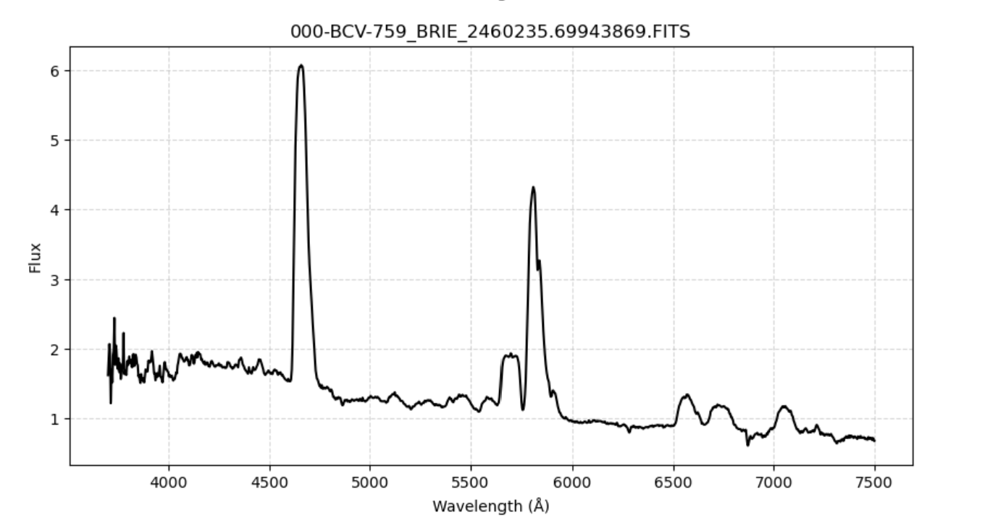
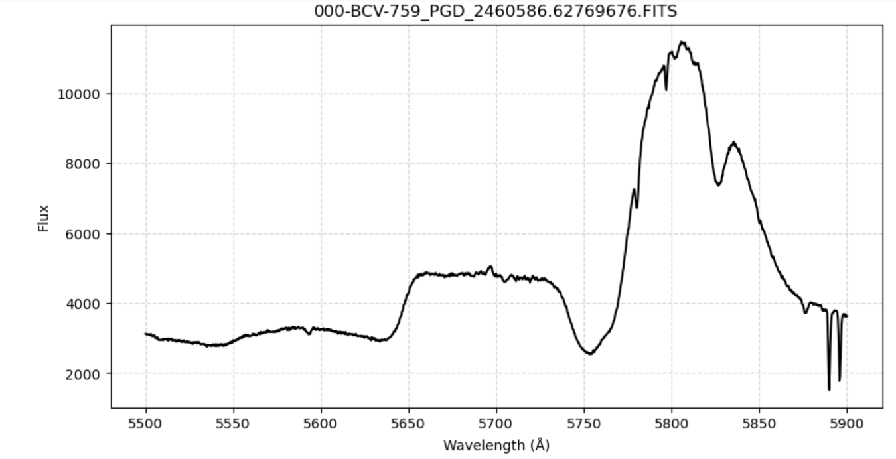
Preliminary results
Spectra taken by amateur astronomers through the American Association of Variable Star Observers
https://www.aavso.org/about-avspec

Slide 10
Future Work
We have fully reduced the data and are now starting the prosses of analyzing how the stars moved during their closest approach.
Next steps:
Measure velocities of O star and WR star in the system for each spectrum.
Combine our new measurements with those of Thomas et al. (2021) in order to measure masses with higher precision.
Meas

Slide 11
References
Thomas, J. D., Richardson, N. D., Eldridge, J. J., Schaefer, G. H., Monnier, J. D., Sana, H., ... & Zurmühl, U. (2021). The orbit and stellar masses of the archetype colliding-wind binary WR 140. Monthly Notices of the Royal Astronomical Society, 504(4), 5221-5230.
Prescott Observatory Team for Analyzing Telescopically Observed Echelle Spectra (POTATOES)
NASA/ESA/CSA/STScl/JPL-Caltech. “Dust Rings in the Wolf-Rayet 140 System.” NASA Jet Propulsion Laboratory (JPL), 12 Oct. 2022, www.jpl.nasa.gov/images/pia25432-dust-rings-in-the-wolf-rayet-140-system/. Accessed 1 Apr. 2026.
Williams, Peredur . “Orbital Motion of WR140.” Roe.ac.uk, 2 Oct. 2015, www.roe.ac.uk/~pmw/Wr140orb.htm. Accessed 1 Apr. 2026.
Tuthill, Peter & Monnier, John & Danchi, W.. (1999). A dusty pinwheel nebula around the massive star WR104. Nature. 398. 487-489. 10.1038/19033.

